Slide 1

School of Computer Science and Artificial Intelligence , SR University
TEAM DETALIS
A.SATHWIK
MOSES ANTHOY
JEVAN REDDY
KARTHIK REDDY
Faculty Name: Dr. Mathivanan D

Slide 2
School of Computer Science and Artificial Intelligence , SR University
Course Name
AI ASSISTED CODING
PROJECT TITLE
AI Disaster Alert & Safety Assistant

Slide 3
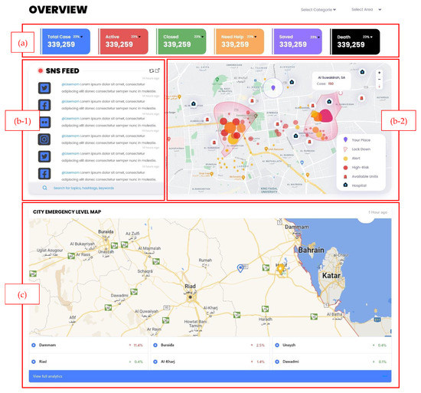
Slide Title
Introduction
Natural disasters such as floods, earthquakes, cyclones, and fires cause severe damage to life and property every year. During such emergencies, people often lack real-time information and proper safety guidance, which increases the risk of harm.
To address this problem, we developed an AI Disaster Alert & Safety Assistant, which uses artificial intelligence to analyze potential disaster situations based on user input. The system identifies the type of disaster, predicts the risk level (Low, Medium, High), and provides instant safety instructions along with emergency contacts.
This project aims to enhance disaster preparedness and provide quick, intelligent assistance to users during critical situations.
Notes:
The algorithms powering these tools are trained on vast amounts of existing source code, typically from publicly available open-source projects. Based on these examples, the algorithms can generate custom code on demand, via text prompts.

Slide 4
Slide Title
Objectives
To develop an AI-based system that performs real-time disaster risk analysis based on user input.
To classify disaster risk levels into Low, Medium, and High using intelligent analysis.
To provide instant safety measures and precautionary steps during emergencies.
To display relevant emergency contact information for quick assistance.
To enhance public awareness and disaster preparedness using artificial intelligence.
To provide a user-friendly and interactive interface that allows users to easily input locations and receive disaster alerts.
Notes:
AI-assisted coding uses artificial intelligence and advanced machine learning to help generate code automatically
These tools allow developers to describe in English or other native language what they want their code to do and then have the tool generate the code to accomplish that task.
This includes the creation of common elements such as custom variable names and the calling of external modules or services.
AI code tools can also translate code from one language to another

Slide 5
Slide Title
Stakeholders
General Public:
The primary users of the system who receive real-time disaster alerts, risk levels, and safety instructions to protect themselves during emergencies.
Disaster Management Authorities:
Organizations responsible for planning and responding to disasters. They can use this system for quick decision-making and efficient coordination.
Government Agencies:
Authorities that implement safety policies and provide resources during disasters. The system helps them improve public safety and communication
Emergency Services (Fire, Ambulance, Rescue Teams):
First responders who act during critical situations. The application provides quick access to emergency contacts and supports faster response.
Notes:
Artificial Intelligence (AI) is revolutionizing the way software is developed. AI-Assisted Coding is the integration of intelligent tools and models into the software development lifecycle to improve code quality, enhance productivity, and reduce development time. From code completion and bug detection to automated documentation and test generation, AI tools are becoming indispensable assets for developers.
This course aims to introduce learners to the evolving landscape of AI in coding, explore various tools and platforms, and understand both the potential and boundaries of this technological shift.

Slide 6
Slide Title
🛠️ Programming Languages, Tools & Software
JavaScript
HTML
CSS
💻 Languages
🎨 Frontend
⚙️ Backend
🧰 Tools
React.js
Vite
Node.js
Express.js
Leaflet
Axios
Framer Motion
Notes:
AI-assisted coding uses artificial intelligence and advanced machine learning to help generate code automatically
The algorithms powering these AI Assisted Coding tools are trained on vast amounts of existing source code typically from publicly available open-source projects.
AI Assisted Coding tools generate the code based on text prompts

Slide 7
Slide Title
AI Prompts Used to Generate Code (PART 1)
🧠 Main System Prompt:
We are using a structured AI prompt to simulate real-time disaster intelligence and safety guidance.
💻 Code Generation Prompts
🔹 1. Frontend UI Prompt:
Create a modern AI disaster alert dashboard using HTML, CSS, and JavaScript with dark theme and glass morphism design.
🔹 2. Disaster Detection Logic:
Write a JavaScript function to detect disaster types based on user input keywords like flood, earthquake, fire, cyclone.
🔹 3. Risk Level Prediction:
Generate logic to classify disaster risk levels into LOW, MEDIUM, and HIGH based on input severity.
🔹 4. Safety Measures Generator:
Provide safety steps and precautions for different disasters like flood, earthquake, and fire.
🔹 5. Map Integration:
Integrate Leaflet.js map to display user location and disaster area dynamically.
🔹 6. Backend API Prompt:
Create a Node.js Express API to handle AI requests and return disaster analysis results.
User Input Handling:
Write JavaScript code to take user input for location and trigger analysis on button click or Enter key.

Slide 8
AI Prompts Used to Generate Code(PART 2)
Alert Message Generation:
Generate dynamic alert messages based on disaster type and risk level.
Safety Measures:
Provide safety steps for each disaster type such as flood, earthquake, cyclone, and fire.
Emergency Contacts:
Display relevant emergency contact numbers for different disaster scenarios.
Voice Alerts:
Add speech synthesis to announce high-risk alerts automatically.
Voice Input:
Implement voice recognition to allow users to input location using speech.
API Integration (Real-time Data):
Fetch real-time earthquake data using USGS API and integrate it into the system.

Slide 9
Slide Title
Flowchart
Start
User Enters Location / Voice Input
Input Processing (Text Analysis)
Disaster Detection (Keyword Matching)
Risk Level Prediction (Low / Medium / High)
Generate Alert Message
Display Results:
Disaster Type
Risk Level
END
Safety Steps
Emergency Contacts
Map Visualization
Notes:
AI-Assisted Coding Tasks
Code Completion
Predicts and suggests the next line or block of code as you type.
Helps speed up development and reduce syntax errors.
Code Generation
Generates code from natural language descriptions or comments.
Converts high-level requirements into functioning code snippets.
Code Translation
Converts code from one programming language to another.
Useful for migrating projects or learning new languages.
Bug Detection and Fixing
Identifies potential bugs or errors in code.
Suggests fixes or automatically corrects them.
Code Refactoring
Improves code structure without changing its behavior.
Enhances readability, performance, and maintainability.
Test Case Generation
Automatically creates unit and integration tests for given functions or classes.
Ensures better test coverage and reliability.

Slide 10
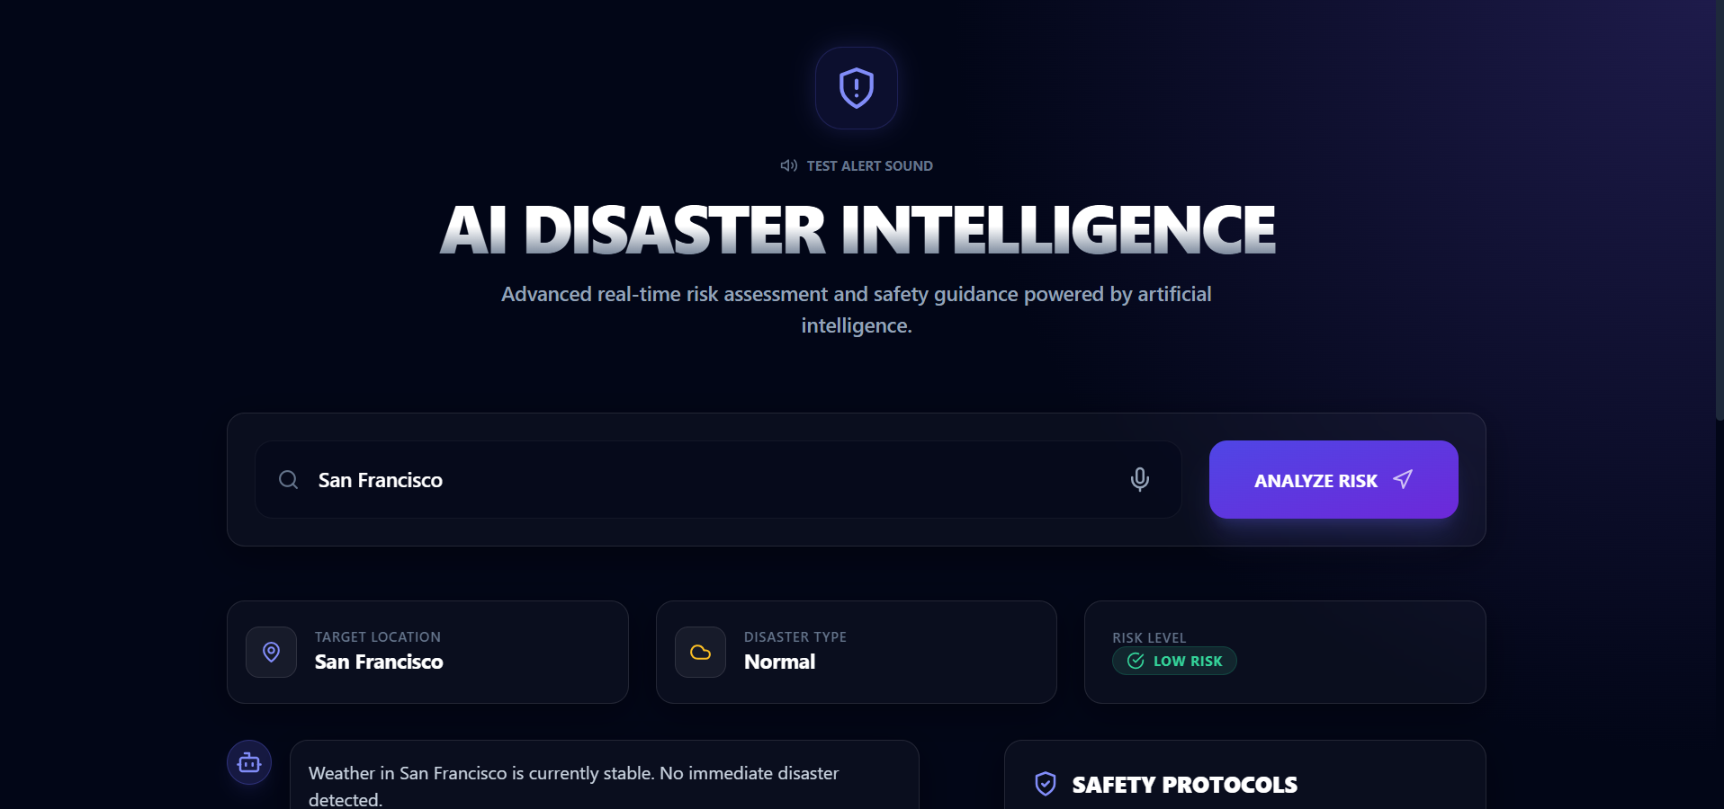
Slide Title
Front-end view of your web/mobile application
Notes:
Code Documentation
Generates comments and documentation from the code.
Saves time and improves understanding for others reading the code.
Code Summarization
Provides a high-level summary or explanation of a code block.
Useful for learning or reviewing unfamiliar codebases.
Syntax and Style Correction
Enforces coding standards and formatting rules.
Corrects indentation, naming conventions, and style violations.
Natural Language Query to Code Search
Finds relevant code snippets or functions based on plain language queries.
Helps developers quickly locate needed components.
API Usage Suggestions
Recommends correct and efficient ways to use APIs or libraries.
Reduces the need to constantly refer to documentation.

Slide 11
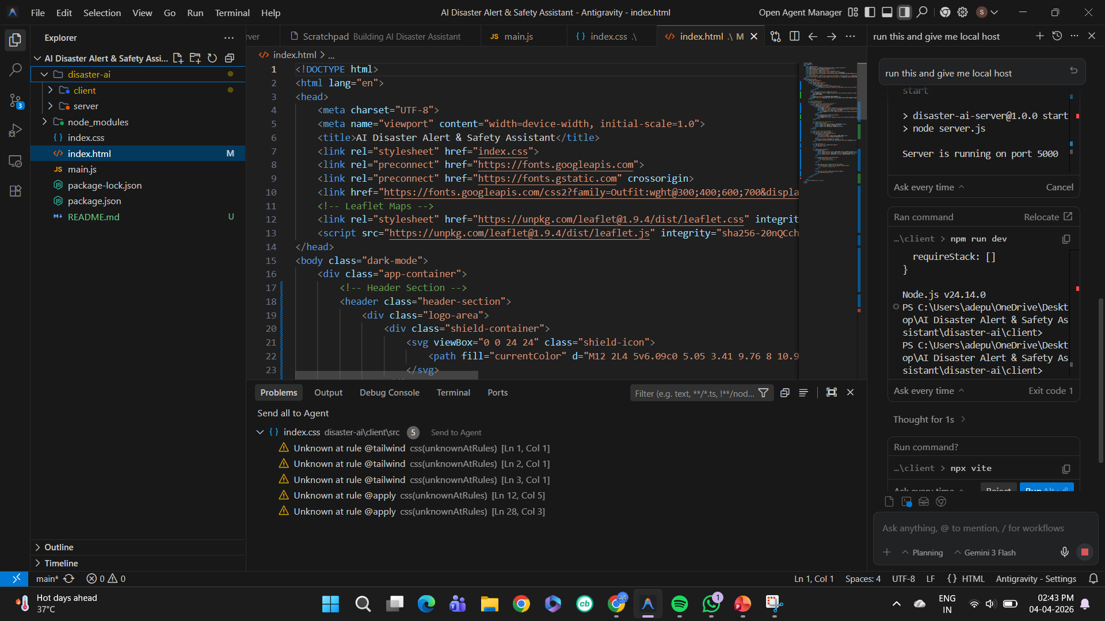
Slide Title
Proof of Prompts generating codes
Notes:
Code completion tools
Debugging tools
Security tools
Testing Tools
Code Review tools
Code Generation tools
Optimization tools

Slide 12
Slide Title
📚 References & Project Resources
📖 References
Google AI Studio (Gemini API)
USGS Earthquake API (real-time data source used in logic)
Leaflet.js Documentation (map integration)
Node.js & Express Documentation
MDN Web Docs (HTML, CSS, JavaScript)
GitHub (project inspiration & resources)
🌐 Software Application / Website URL:
https://aidiastermanagment.netlify.app/
Notes:
Code completion tools leverage AI to predict and suggest the next line or block of code a developer is likely to write based on the current context of the code being written. They analyze the syntax and semantics of the written code to provide relevant and accurate suggestions, minimizing the likelihood of errors and enhancing coding efficiency.

Slide 13
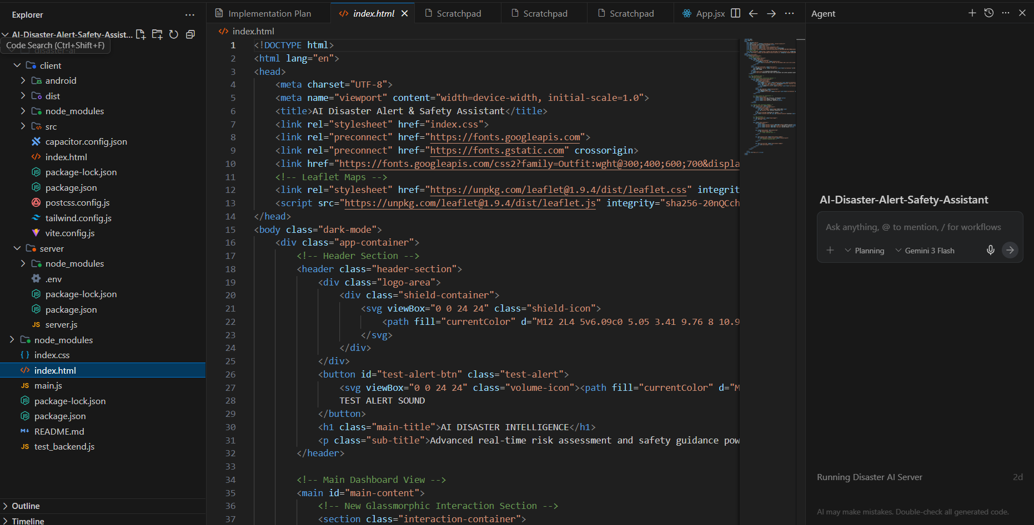
Slide Title
SOURCE CODE:
Notes:
AI-powered debugging tools utilize advanced algorithms to detect and correct errors in the code automatically. They streamline the debugging process by identifying the root causes of issues and suggesting appropriate fixes, reducing the time and effort developers need to spend on debugging.
Rookout: This tool allows developers to set non-breaking breakpoints and fetch the needed data without stopping the code or adding extra code lines, leveraging AI to streamline the debugging process.

Slide 14
Slide Title
THANK YOU
Notes:
Increased Productivity in AI-assisted coding means that developers can complete tasks more quickly and efficiently by leveraging AI tools. This includes:
Faster code writing through intelligent autocompletion
Reduced time spent on debugging and error fixing
Quick generation of repetitive or boilerplate code
Automated documentation and testing
Fewer context switches (less need to search for syntax or examples)
Improved focus on logic and design instead of syntax
Faster Code Development
Improved Code Quality
Reduced Syntax and Logical Errors
Automated Code Documentation
Quick Bug Detection and Fixing

